Slide 1
Group 10
Sprint 1

Slide 2
Progress
Roles and Task allocation
Planning and Scheduling
Requirements Analysis
UML Design
Database connectivity
Set up login permissions
Completed login design
Laid out initial code

Slide 3
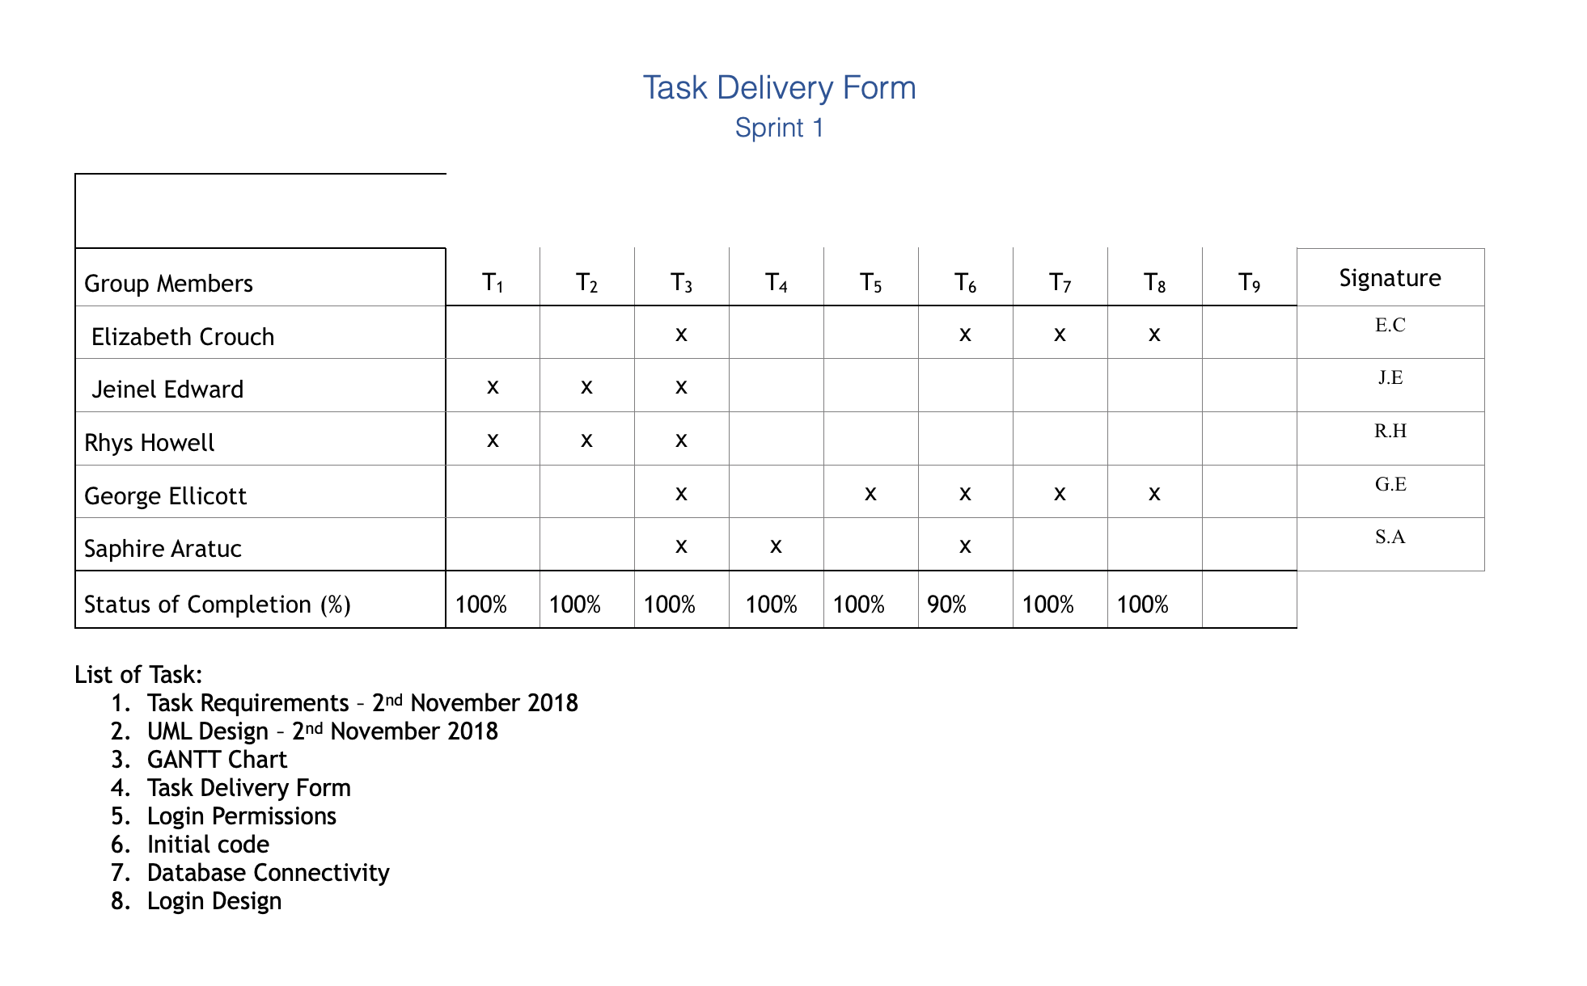
Roles and task Allocation

Slide 4
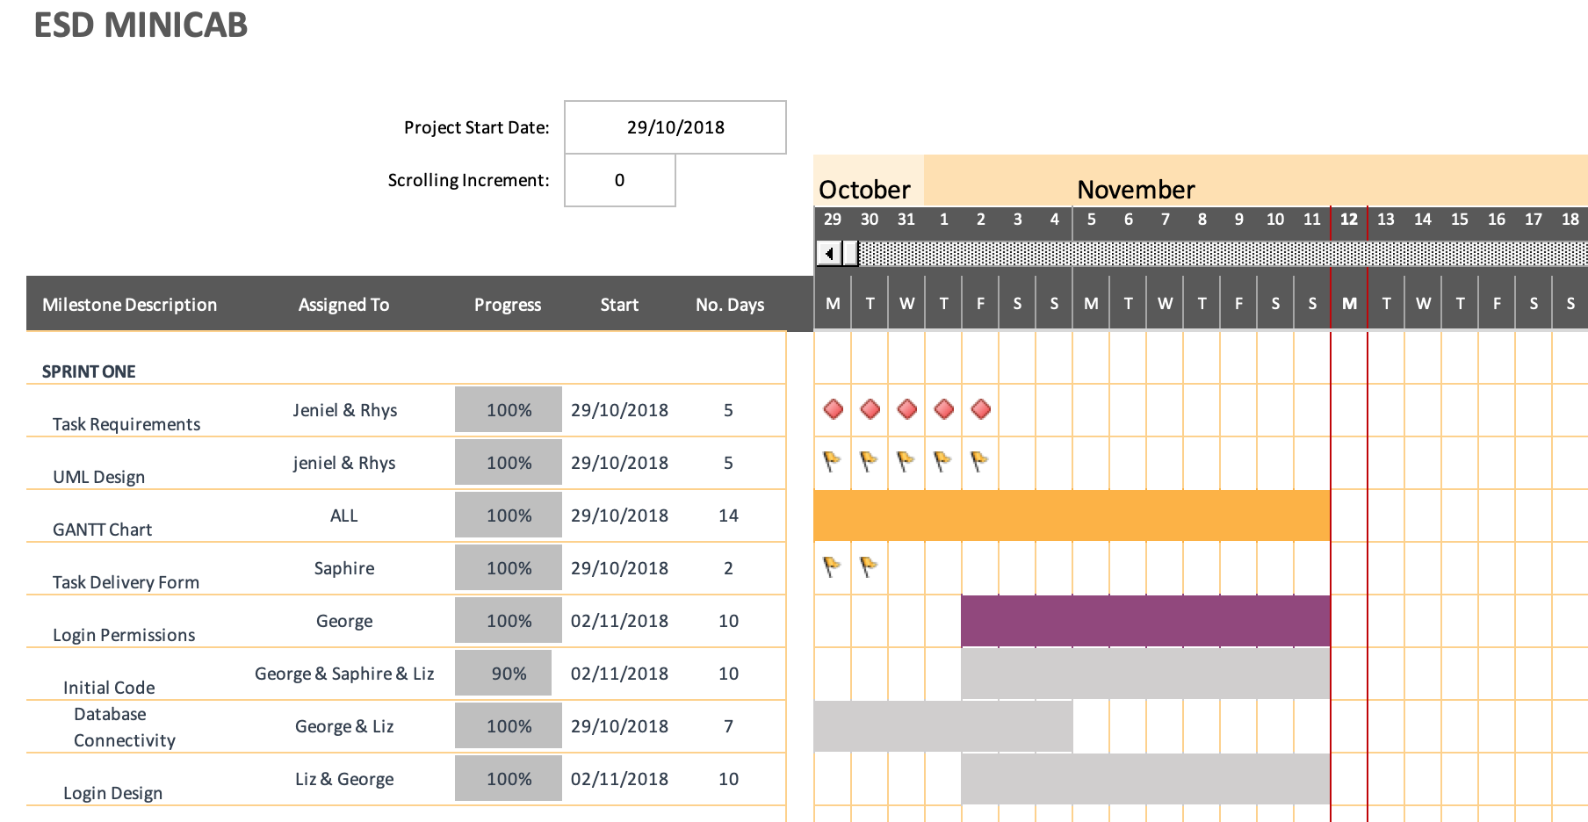
Planning and Scheduling

Slide 5
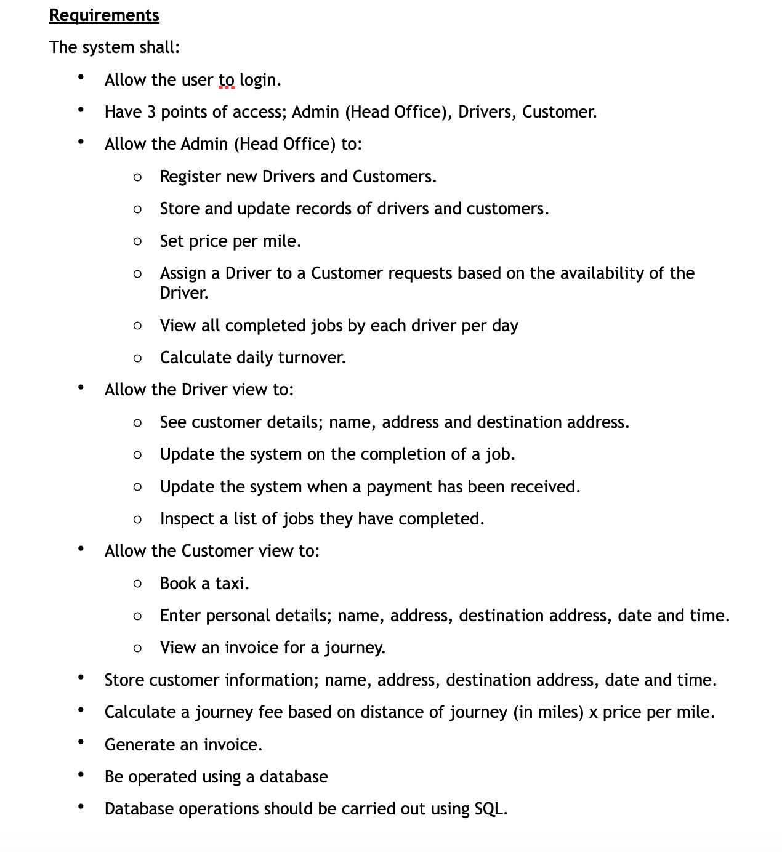
Requirements analysis

Slide 6
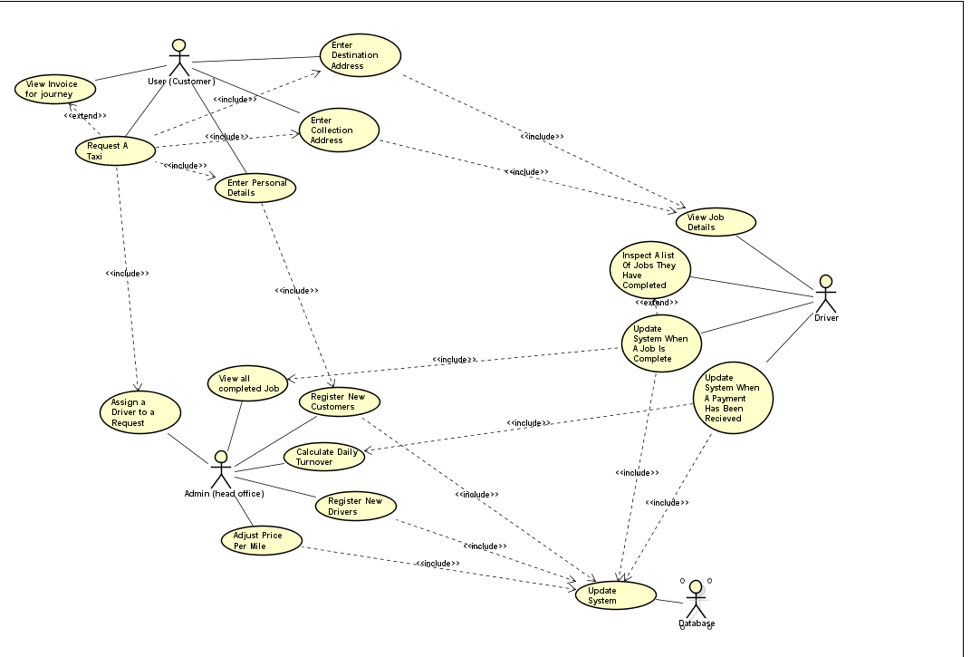
Use Case Diagram

Slide 7
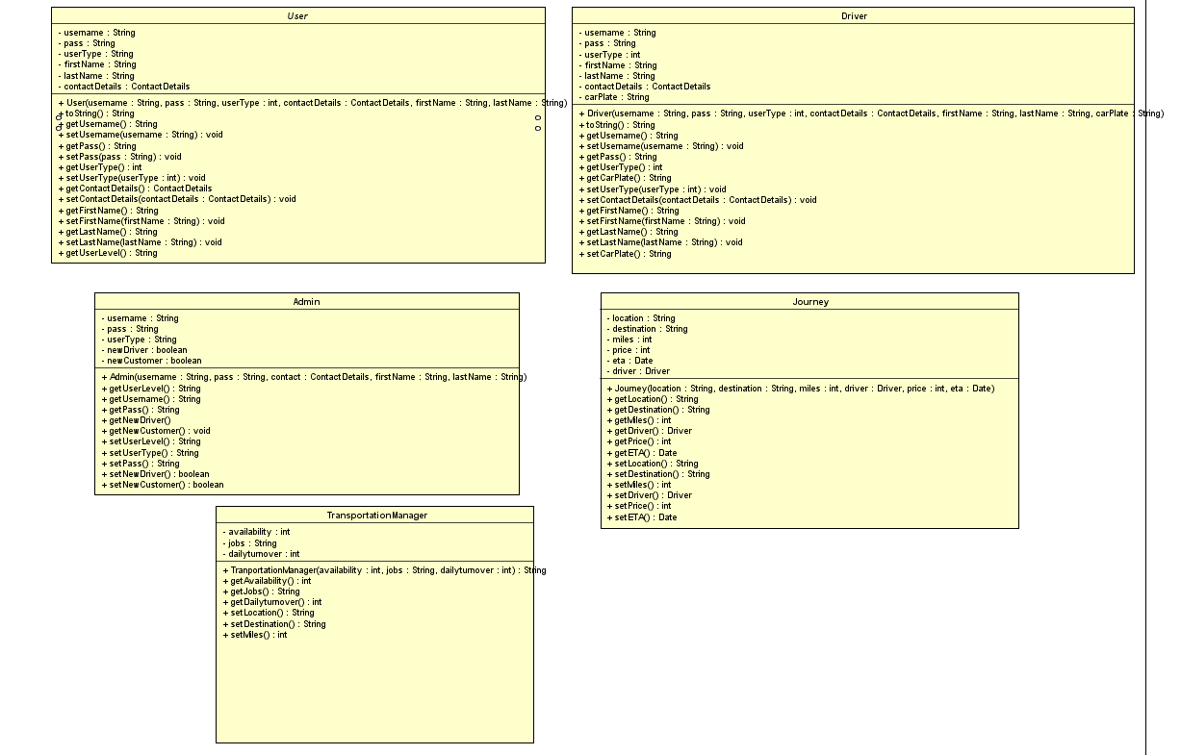
Class Diagram

Slide 8
Database Connectivity
Try {
Class.forName(“org.apache.derby.jdbc.ClientDriver”);
Conn = DriverManager.getConnection(“jdbc:derby://localhost:1527/MiniCabdatabase","username","password");
}

Slide 9
LOGIN DESIGN AND PERMISSIONS
LOGINPAGE SERVELET.
if (query[0].equals("") || query[1].equals("")) {
session.setAttribute("message", "Username or Password cannot be NULL");
} else if (jdbc.existsForlogin(query[0], query[1])) {
if (jdbc.role(query[0], query[1]) == "admin") {
request.setAttribute("message", "Logged in as " + query[0]);
request.getRequestDispatcher("adminView.jsp").forward(request, response);
} else if (jdbc.role(query[0], query[1]) == "driver") {
request.setAttribute("message", "Logged in as " + query[0]);
request.getRequestDispatcher("driver.jsp").forward(request, response);
}
else {
request.setAttribute("message", "Logged in as " + query[0]);
request.getRequestDispatcher("customer.jsp").forward(request, response);
}

Slide 10
Login Design and Permission
SETTING THE PERMISSIONS:
public String role(String user, String password){
String userRole ="";
try {
select("select * from users where username='" + user + "'"+ " AND password='" +password+"'"+" AND role='admin'");
if (rs.next()) {
System.out.println("TRUE");
userRole = "admin";
return userRole;
}
select("select * from users where username='" + user + "'"+ " AND password='" +password+"'"+" AND role='driver'");
if (rs.next()) {
System.out.println("TRUE");
userRole = "driver";
return userRole;
}
select("select * from users where username='" + user + "'"+ " AND password='" +password+"'"+" AND role='customer'");
if (rs.next()) {
System.out.println("TRUE");
userRole = "customer";
return userRole;
}

Slide 11
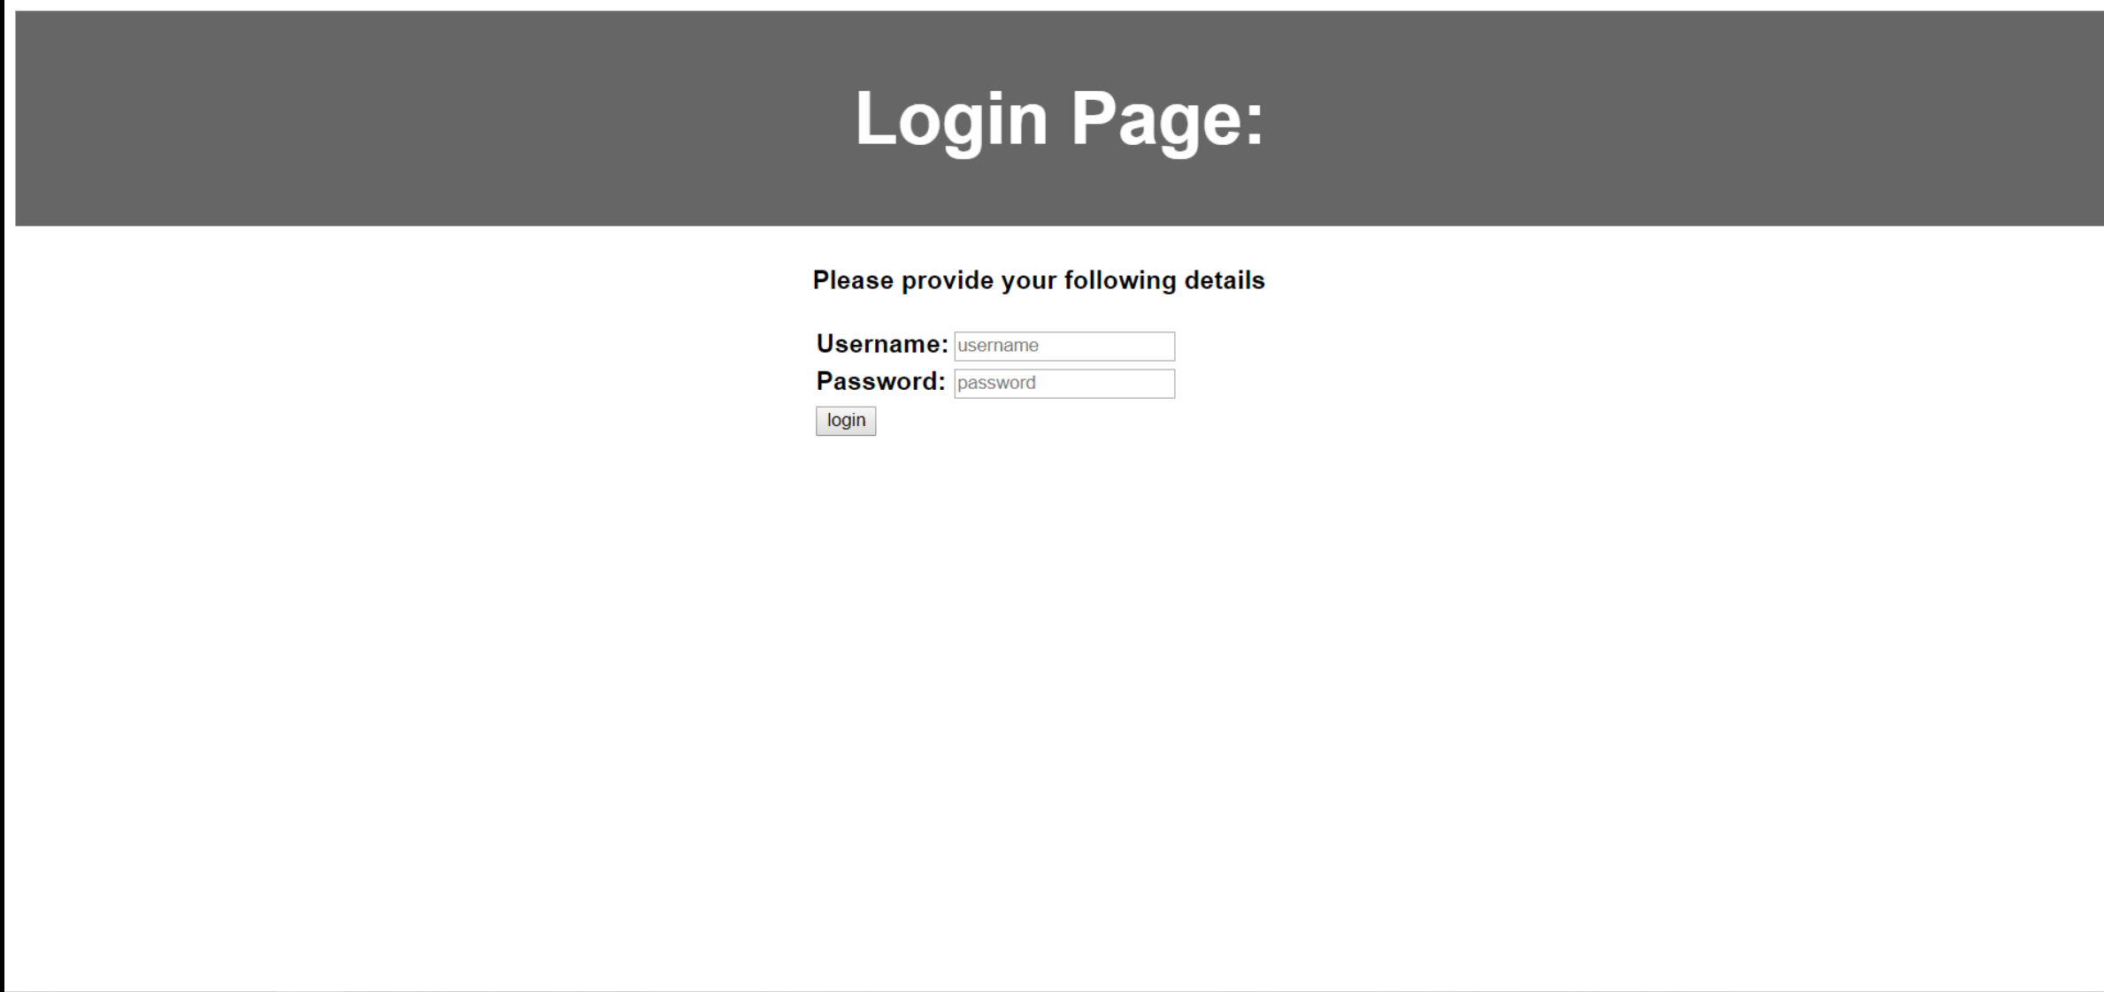
Initial code

